Slide 1
ECII/ECSI 3206: Artificial Intelligence [and expert systems] Topic 5: Fuzzy logic and Fuzzy Logic Systems
By: Edgar Otieno

Slide 2
Introduction to Fuzzy Logic
Fuzzy-This defines when something is not clear or when something is vague[vagueness]
Fuzzy Logic- This is a method of reasoning that resembles human reasoning and it involves finding all the possibilities between a digital Value of YES or NO, True or False, 0 or 1.

Slide 3
Forms of Knowledge in Fuzzy Logic
Knowledge exists in two forms when considered within a fuzzy logic perspective
Objective knowledge[mathematical form]
Subjective knowledge[linguistic form]
Fuzzy logic can coordinate these two forms of knowledge in a logical way.

Slide 4
Human vs Computer Decision making
Unlike computers , human decision making includes a range of possibilities between YES and NO i.e
Certainly YES
Possibly YES
Cannot say
Possibly NO
Certainly NO

Slide 5
Cont…
Fuzzy Logic works on the levels of possible inputs to achieve some desired output
It can be implemented in the form of Hardware, Software or Both H/W and S/W.

Slide 6
Merits of FLS
Fuzzy logic Systems can take imprecise, distorted, noisy input information.
FLSs are easy to construct and understand.
Mathematical concepts within fuzzy reasoning are very simple.
You can modify a FLS by just adding or deleting rules due to flexibility of fuzzy logic.
Fuzzy logic is a solution to complex problems in all fields of life, including medicine, as it resembles human reasoning and decision making.

Slide 7
Demerits of FLS
They are understandable only when simple.
There is no systematic approach to fuzzy system designing.
They are suitable for the problems which do not need high accuracy.

Slide 8
Applications of F.L.S
Automotive Systems[Gearbox , Vehicle A/C]
Electronic goods[TV, Camera, Fridge, Washing Machine]
Navigation Systems[Autopilot]
Robot Vision

Slide 9
Fuzzy Logic Systems Architecture
It is made up of four main parts as follows:
Fuzzification module
Knowledge base
Inference engine
Deffuzification module
Member Function

Slide 10
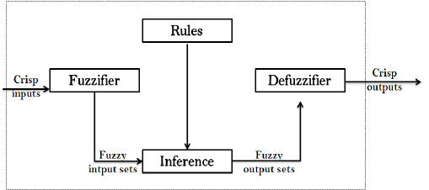
Diagram of a F.L.S
Member function

Slide 11
1.Fuzzification module
Fuzzification is a process of transforming crisp values into grades of membership for linguistic terms of fuzzy sets. The purpose is to allow a fuzzy condition in a rule to be interpreted.
-It transforms crisp input into fuzzy sets e.g It splits input X into 5 steps LP,MP,S,MN,LN

Slide 12
2. Knowledge base/Rules
-This component stores the IF …… THEN rules provided by the various experts in a given field
-A collection of rules referring to a particular system is known as a fuzzy rule base.
IF (a set of conditions) are satisfied THEN (a set of consequents) can be inferred.

Slide 13
Cont..
IF(x₁ isA₁, x₂ isA₂, x_{n} is A_{n}) THEN(y₁ is B₁, y₂ is B₂, y_{n} is B_{n}) where linguistic variables x_{i}, y_{j} take the values of fuzzy sets A_{i} and B_{j} respectively.
Example
IF there is "heavy" rain and "strong" winds THEN there must "severe" flood warnings. Here, heavy , strong , and severe are fuzzy sets qualifying the variables rain, wind, and flood warnings respectively.

Slide 14
3.Inference Engine/Intelligence/Fuzzy Inference
It is the core element of a fuzzy system.
It simulates human reasoning process by making reference to the inputs and the IF…THEN rules that are stored in the knowledge base then conducts the fuzzy reasoning process(Approximate reasoning)
It uses the principles of Modus Ponens and Modus Tollens

Slide 15
Cont..
Modus Ponens
If P and P → Q are premises, we can us Modus Ponens to derive Q. e.g If you have a password, you can log into your TUK account. Having a password[P],that implies that you can log into your TUK account[P → Q ].

Slide 16
Cont…
Modus Tollens
If P → Q and ¬Q are premises, we can use Modus Tollens to derive ¬P. e.g If you have a password ,you can log into your TUK account P → Q .If you cannot log into your TUK Account [¬Q ], that means that you don’t have a password[¬P].

Slide 17
4. Defuzzification module
This component transforms the fuzzy set obtained by Inference engine into Crisp output
Defuzzification is the reverse process of Fuzzification.

Slide 18
Member Function
It is a function which allows us to quantify linguistic terms and represent fuzzy sets graphically.
The member function for a fuzzy set A on the universe of X is given as below
M_{A}:X → [0,1]
[Where the distance between 0 and 1 represent the degree/value of membership.]

Slide 19
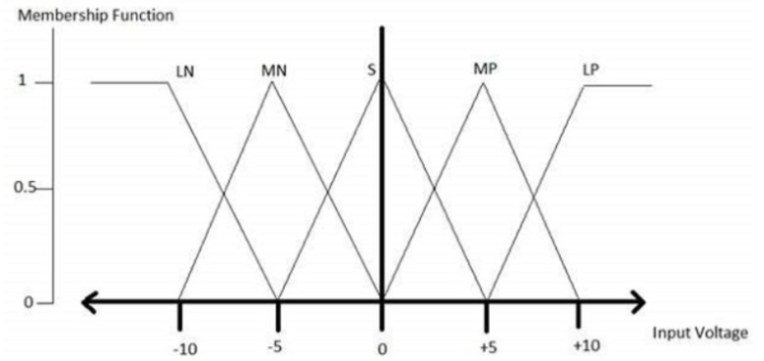
Graphical Representation of a member function
This example assumes a five level Fuzzifier

Slide 20
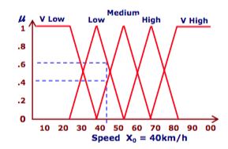
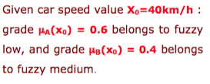
Cont..
Member function Graph for the speed of a car [assuming that the medium speed is 55km/h]. Consider a car moving at 44km/h..

Slide 21
Crisp Logic vs Fuzzy(non crisp) Logic
Consider the examples below: Example 1.
If someone is >=1.8 m in height, we say you are “tall”, otherwise, we say you are “not tall”. “Tall” students qualify to be members of a basketball team while “non tall” students don’t qualify. What if a student is 1cm shorter e.g 1.79m?

Slide 22
Cont….
A student of 1.79m would belong to both “tall” and “not tall” but what varies is the degree of membership.
As a student’s height increases, their membership within the “tall” category would also increase while their membership within the “non tall” category would decrease

Slide 23
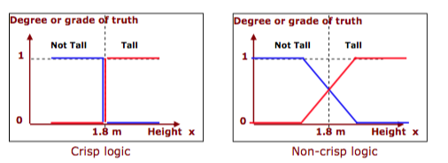
Cont…
Representation in the form of crisp and non crisp[fuzzy values]

Slide 24
Cont…
Consider the examples below: Example 2.
Consider the set of numbers between 1 and 12 .
This can be represented as 1>=x<=12
Consider the prime numbers within this set{2,3,5,7,11}(crisp set)
How would the graphical representation of the prime numbers look like?

Slide 25
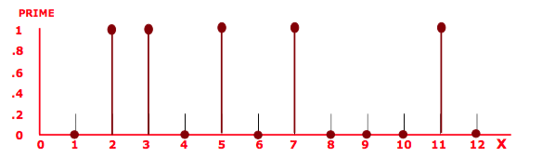
Cont…

Slide 26
Cont..
Also using the same set of 1to 12, Consider a set of all small numbers between 1 and 12.(non crisp set)
We make the assumption that 1 is a small number but 12 is not a small number. Therefore , we can represent this using a Universal space.[ A universal space is a way used to describes the start, end and increment of a set] e.g Universal Set x={1,12,1}
How would the graphical representation of the prime numbers look like?

Slide 27
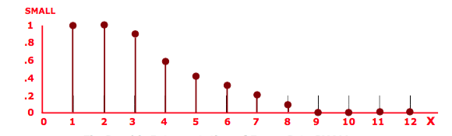
Cont..

Slide 28
Cont..
Universal sets can be finite or infinite. Any universal set is finite if it consists of a specific number of different elements, that is, if in counting the different elements of the set, the counting can come to an end, else the set is infinite.
Examples: 1. Let N be the universal space of the days of the week. N = {Mo, Tu, We, Th, Fr, Sa, Su}. [N is finite]
2. Let M={1,3,5,7,9,...}. [M is infinite]
3. Let L={u|u is a lake in a county}. [L is finite] (Although it may be difficult to count the number of lakes in a county, but L is still a finite universal set.)

Slide 29
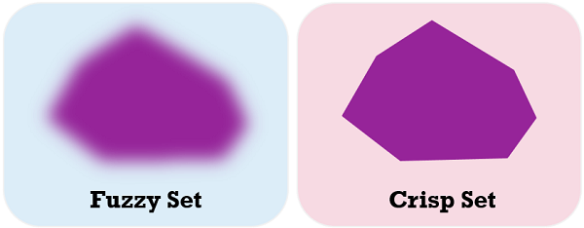
Fuzzy vs Crisp[Non Fuzzy set]

Slide 30
Cont….
A Fuzzy Set is any set that allows its members to have different degree of membership, called membership function, in the interval [0 , 1].

Slide 31
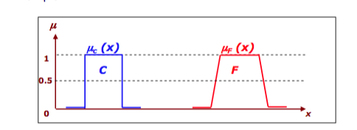
Capturing Uncertainty
A member function for a Crisp set and non crisp set. Crisp set is a subset of fuzzy set

Slide 32
Algorithm For Functioning of FLS
1.define linguistic variables/terms
2.Construct membership function[m.f]
3.Construct Rule base/Knowledge Base
4.Convert Crisp input into a fussy dataset using member function[Fuzzification]
5.Evaluate rules in the Knowledge Base
6. Combine results for each Rule
7.Convert Fuzzy output into Crisp output[ Deffuzification]

Slide 33
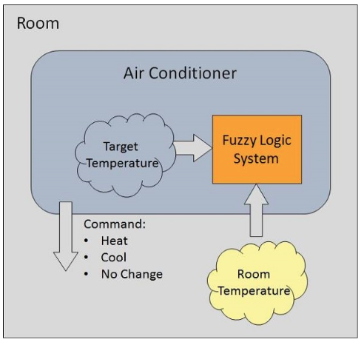
Real world Example
Consider an Air conditioning System with a 5 level Fuzzy Logic System. The system adjusts temperature by comparing the room temperature and the target temperature.

Slide 34
1. Define linguistic Variables
The temperature ranges can be either :
VC-Very cold
C-Cold
W-warm/Normal
H-Hot
VH-very Hot

Slide 35
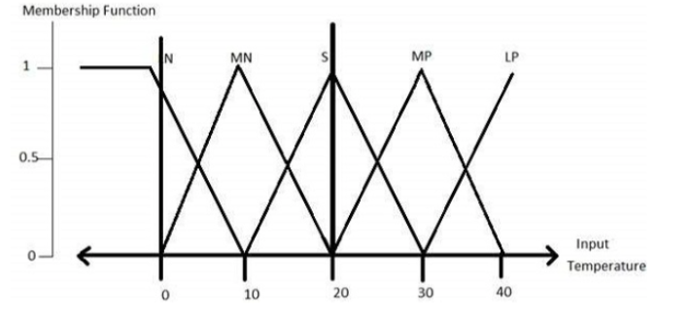
2. Construct member Function[m.f]

Slide 36
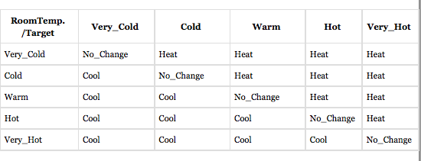
3.Construct Knowledge Base/Rule Base

Slide 37
4.Convert Crisp input into a fussy dataset using member function[Fuzzification]
In this case , we will convert the table in Step 3. into rules
RULE | CONDITION | ACTION
1 | IF Room Temp=C or VC and T.T=W THEN | HEAT
2 | IF Room Temp=H or VH and T.T=W THEN | COOL
3 | IF Room Temp=W and T.T=W THEN | NO CHANGE

Slide 38
Other steps[5,6,7]
After these the Air conditioning system will perform the next three remaining steps so as to make adjustments to the target temperature
5.Evaluate rules in the Knowledge Base
6. Combine results for each Rule
7.Convert Fuzzy output into Crisp output[ Deffuzification]

